Slide 1
CASH-LESS NIGERIA: THE JOURNEY SO FAR
CBN Staff Engagement Session
SHARED SERVICES OFFICE
May 2012

Slide 2
Outline
  Context -Shared Services Program
  The Cash policy
  Cash-less Lagos
  Cash-less Nigeria
  Conclusion

Slide 3
Background
CBN, in conjunction with the Banker’s committee embarked on a Shared Services program to drastically reduce the industry’s cost to serve
Context
In the wake of the banking industry intervention, our analysis indicated that the high cost structure of the banks was partially responsible for their preference for lending to the capital market and oil & gas industry which led to asset bubbles
Embedded within lending rates and cost of banking services are operating expenses arising from inefficiencies in the provision of banking services.
The Bankers Committee in conjunction with the CBN commissioned a study which identified cost drivers in the industry and the possibility of achieving 30% cost reduction with the attendant positive impact on lend-
ing rates and bank charges.
  Reduce Industry cost-to-serve by 30%
  Increase access, convenience and service levels across the Industry
  Enable greater financial inclusion and integration of financial services into the economy, with its attendant positive impact on economic development
1
2
3

Slide 4
Overview: CBN, in conjunction with the Banker’s committee embarked on a Shared Services program with three key objectives, including a drastic cost reduction of 30%
Shared Services Program
Cash Management
Payment Systems Transformation*
IT Infrastructure & Services
IT Standards
Back Office Operations
  Industrialize Cash Management & Logistics (Storage, Processing & Movement)
  Facilitate growth of electronic payments
  Increase availability, reliability and security of electronic channels
  Increase efficiency and reduce cost of operations/maintenance for IT and infrastructure (application management, data centre, shared network, shared power, etc)
  Align IT standards across the Industry to improve efficiency, while driving data integrity and enabling information exchange
  Enable cost reduction through shared back office operations (centralized processing, collections; etc)
1
  Reduce Industry cost-to-serve by 30%
2
  Increase access, convenience and service levels across the Industry
3
  Enable greater financial inclusion and integration of financial services into the economy, with its attendant positive impact on economic development
NIBSS Transformation
CBN Process Re-Engineering
  * Payments is the key driver of cost of distribution, which accounts for almost 60% of the industry cost base
Notes:
4

Slide 5
IT Standards & IT infrastructure
The Office is developing modalities/work plan for implementation of the following initiatives:=
  Shared tier-3 Disaster Recovery Centre infrastructure and services
  Shared power infrastructure as a service to the banks
  Nigeria Financial Services Network (NFSN)
The Office is also setting up an IT standards Board and requisite governance framework to oversee the administration of IT standards in the industry and drive its adoption across the players in the industry

Slide 6
Shared Disaster Recovery Centre
The Shared DRC will enable Nigeria’s financial institutions to ensure continuous operations in the event of a disaster
The U.S. Trade and Development Agency (USTDA) has provided a grant to CBN for the initial project phase.
The grant will be used to finance a qualified U.S. firm to provide expert consulting services in determining the technical requirements and business and operational models for a shared disaster recovery center (DRC)
Vendor has been evaluated and selected
Received letter of "no objection" from USTDA
Legal is drafting contract agreement.

Slide 7
Payment System Transformation and Cash Management
Payment System Transformation
Cash Management
Payment is the key driver of cost distribution in the industry and accounts for almost 60% of the industry cost base
Cash management constitutes almost 80% of bank infrastructure and staff. Therefore driving up the cost of banking service.
Implication
Licensed CIT companies
Drive e-payment deployment and usage to reduce the amount of cash in circulation.
The cash policy
NIBSS transformation.
Working with banks to ensure more efficiency in the payment system.
Initiative

Slide 8
Why Cash-less?
Cash transactions represented over 99% of customers activity in banks as at year end 2011.
Payment Channel | Volume
ATM Withdrawals | 109,592,646
OTC Cash Withdrawals | 72,499,812*
Cheques | 29,159,960
POS | 1,059,069
Web | 2,703,516
Daily Non Cash transactions (As at MAY 2012)
Payment Channel | Volume | Value
NIBBS Instant Payment (NIP) | 178,109 | 108,363,432,319.09
NIBBS Electronic Funds Transfer (NEFT) | 2,137,271 | 1,074,564,092,880.14
Cheques

Slide 9
The Original Cash Policy
CBN cash transactions Policy stipulated that;
Beginning from 1 January, 2012 banks will encourage their customers by educating and accommodating them to try other payment channels other than cash.
a ‘cash handling charge’ on daily cash withdrawals or cash deposits that exceed N150,000 for Individuals and N1,000,000 for Corporate bodies.
Proposed service charge was 10% for individuals and 20% for corporate entities.
Beginning from March 30th 3rd Party Cheques above N150,000 shall not be cashable over the counter. They must be paid into an account.
Banks will discontinue cash in transit lodgement services. This will be replaced by licensed CIT providers.
The Service charge will not apply until March 30th 2012 in order to give people ample time to migrate to alternative channels.
From June 1st 2012, the policy will be applied in other geo-political zones of the country.

Slide 10
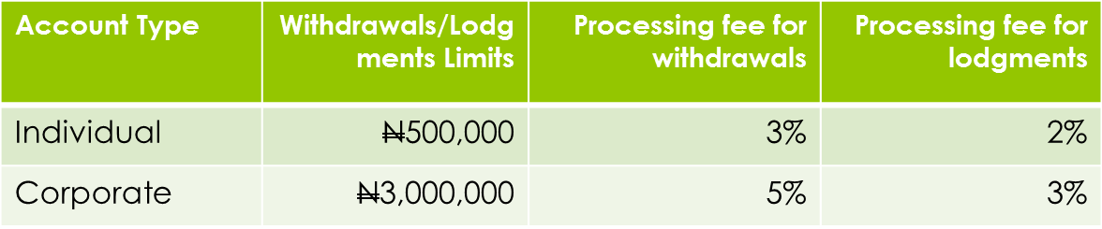
The Reviewed Cash Policy
CBN having monitored the partial implementation of the Policy and following stakeholder engagement on the effective implementation of the project, decided to reassess the policy to allow for smooth transition and adoption.
Consequently, the CBN reviewed the policy as follows:
Exemptions have been granted to Ministries, Departments and Agencies(MDAs) of the federal and state govt. on lodgments for revenue collections accounts ONLY.
The implementation of the newly approved charges in Lagos State commenced on April 1, 2012. (charges are subject to review every six months).
The roll-out of the programme in other states of the federation has been deferred to January 1, 2013

Slide 11
Cash Policy Implementation Challenges
Lack of understanding of cash policy amongst the banked & unbanked
Lack of clarity in communicating content of policy
Resistance due to prevailing cash culture
Techno-fobia (Literacy vs Numeracy)
Infrastructure Lag
Distrust in banking system
Lack of PoS at Priority Locations
Custom Challenges for clearing
Exorbitant bank charges on e-payment products
Need for standardized pricing to encourage usage and adoption
Independent online-real-time monitoring of electronic channels uptime

Slide 12
Consequences of Heavy Cash Usage
  Cash is an integral element that fuels several vices in Nigeria, alternative payment channels will have considerable positive consequences on the economy.
Robberies and cash-related crime
Kidnapping
Election rigging
High cost
of cash handling and processing
Revenue leakage
Inefficient treasury management
Corruption
CASH

Slide 13
Benefits of the cash policy
To meet the Vision 20:20 initiative
To modernize the nations financial system
Facilitate the growth of e-commerce
Reduce the cost of cash management and processing
Reduce the cost of banking service to the customer
Massive reduction in corruption and cash-related crimes
Greater access to world-class financial services
Effectively drive financial inclusion for the un-banked in the society.

Slide 14
Benefits for stakeholders
A variety of benefits are expected to be derived by various stakeholders from an increased utilization of e-payment systems. These include:
For Government:
  Firmer grip on Monetary Policy, and its attendant effect on Inflation and economic stability;
  Increased / transparent tax collection;
  greater financial inclusion;
  Increased economic development;
For Corporations:
  Faster access to capital;
  Reduced revenue leakage; and
  Reduced cash handling costs.
For CBN Staff:
  Increased convenience;
  more service options;
  reduced risk of cash-related crimes;
  cheaper access to (out-of-branch) banking services and access to credit.
  Safety of life and property.

Slide 15


Alternatives to cash have been made available in Lagos and work is on to drive for the entire nation for both retail and wholesale cash users
  CBN working with industry stakeholders have increased the alternative channel penetration, functionality, and ease-of-use
  Point-Of-Sale Systems: Card Neutral (Interoperability); Improved Connectivity; Greater reach/deployment, T+1 settlement
  Mobile Payments: fourteen players fully licensed; few others in pilot mode
  Multi-functional ATMs: Withdrawal, Cash-deposit, Bill payments, etc
  Internet Banking: Intra and Inter Bank funds transfer
  (Instant) Electronic Funds Transfer: Instant transfer option currently offered through NIBSS has revolutionized funds transfer.
  Direct Debits: Automated Direct Debit option being piloted with a few Banks and Billers

Slide 16
POS Deployment status update
;
  Issued POS Guidelines
  Negotiated discounts with POS manufacturers
  Licensed PTSPs and PTSA
  Encouraged banks to order and deploy POS
  Monitor performances of banks, PTSA, PTSPs in respect of POS deployment
In line with the Bankers Committee desire to increase the POS density, the Shared Services Office embarked on a number of initiatives to achieve the set objective. Notable among them are

Slide 17
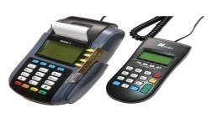
POS Deployment and Performance
Features of the new POS:
24hrs battery life to help save on power outage
2 SIM slots for better connectivity
Car charger for alternative charging
Multi-functional for various transactions e.g. payment, Airtime top-up, cash-back option, etc.
Performance:
POS deployment has been on the increase since December 2011
The cumulative number of POS deployed /connected to NIBSS CTMS stood at 69,905 as at May 20, 2012. This represents an increase of over 100% above the 5,992 recorded as at end of January 2012.
The target of purchasing at least 10,000 POS terminals per vendor has been met for three vendors
Registered merchants reached an all time high at 114,074 as at May 20, 2012.
  The gap between registered vs deployed, is mostly due to lack of capacity on the part of the PTSPs to meet the demand.

Slide 18
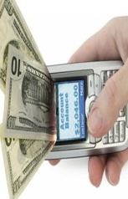
Financial Inclusion Through Mobile Payment Drive
W.H.O Case Study
World Health Organization in collaboration with CBN is putting a framework for using the mobile payment platform to disburse funds to vaccinators in the rural and urban areas were they carry out their functions.
The vaccinators are being paid a stipend of N500 per day for maximum of 4 days for over 2,000 to 4,000 vaccinators per location.
The total amount disbursed per nationwide round is about N500 million ( with 4 more rounds before the year end).
The mobile payment solution will migrate them from cash payments to electronic payment alternatives with emphasis on Mobile payment..

Slide 19

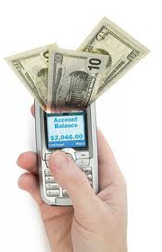
Agent Network Management
The preference for post office is borne out of the need to leverage on existing assets to further drive down cost of taking payments and financial services to the poor
It is also expected that this will be an avenue for addressing unemployment as efforts are being made to ensure that interested parties could easily set up a network with adequate training and back office support of professionals within the ubiquitous network of agents
We are also encouraging integration of mobile payments with POS and ATM to facilitate cash-back services without human agent

Slide 20
Nigeria Electronic Fraud Forum (NEFF)
The NEFF forum comprising all relevant stakeholders, was set up to collaboratively and proactively tackle fraud risks consistently. The Forum has so far achieved the following:
Co-opted the EFCC in order to aid prompt & effective prosecution procedures
Designed and circulated a fraud reporting template to all Deposit Money Banks
Organized a workshop with all key stakeholders in attendance on the topic “Electronic Payments: Current and Emerging Fraud Trends”. This led to quite revealing lapses which all stakeholders made avowed commitments to prevent.
Engaged a Technical Assistant who has varied experience in penetration testing and is also a certified “ethical” hacker to help analyze fraud reports.

Slide 21
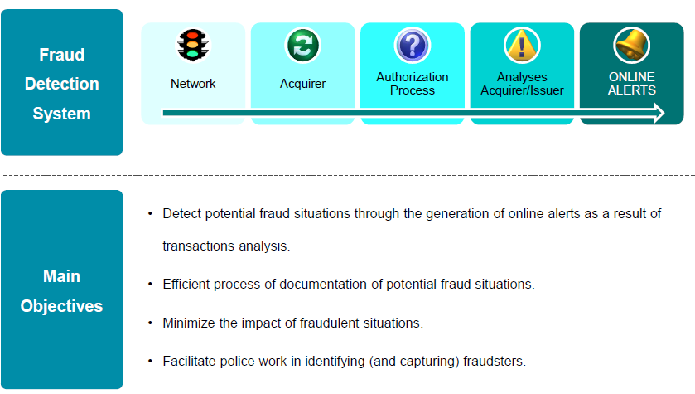
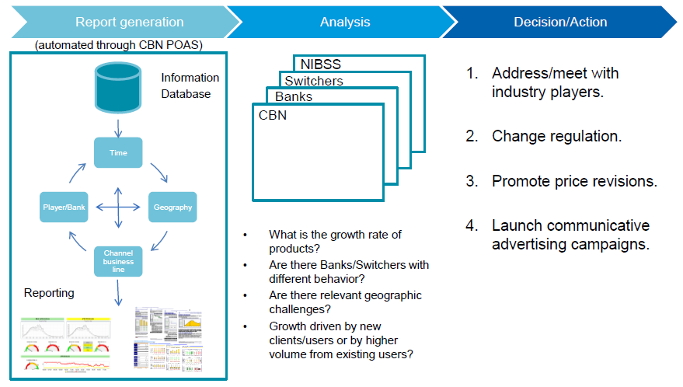
Fraud management on the electronic payments landscape
Nigeria achieved changeover from magnetic stripe based payment tokens and channels to CHIP +PIN compliant channel and tokens in 2010 in a bid to stem fraud in electronic payments thereby recording over 90% drop in card related fraud incidences
The CBN instituted an industry ATM Anti-Fraud Committee which has been recently up scaled to E-Payment Fraud Forum. This group ensures that our anti-fraud mechanism is kept abreast of new challenges for proactive response
Credit/ Settlement Risk has been reduced by shorter clearing cycle
The CBN now has a Payments System Policy and Oversight Office which is saddled with the effective monitoring and regulation of the payments system
We are also in the process of acquiring a Payments System Oversight and Anti-Fraud System for online risk surveillance of the payments system

Slide 22

Consumer Protection and Dispute Resolution
Adoption of electronic payments is usually inhibited by poor dispute resolution and lax consumer protection regime. This can be more debilitating to the objective of financial inclusion for low income earners
This realisation made the CBN to step up actions towards ensuring that users of payments services get adequate attention from providers.
Creation of The Nigerian Electronic Fraud Forum (NEFF) to formulate cohesive and effective fraud risk management strategies.
Additionally banks were made to publicise their complaint desk contacts as CBN leads the way in equally informing the public to contact our desks when there are deviations from the guidelines in the resolutions of their issues as promptly as stipulated
While we are in the process of establishing the Office of the Ombudsman for financial services, the CBN has created a Consumer Protection Division to strengthen users’ confidence and promote adoption.
Office of the Ombudsman
For Financial Services

Slide 23
Bank Coordinators Group
This working group is made up of representatives of all the banks in the country.
The group is mandated to meet on a regular basis as well as communicate on any issues that arise with the Cash policy implementation.
Information sharing
Bank coordinators bring up issues from their banks, PTSPs and service providers to ensure prompt resolution for the smooth implementation of the policy.
Issue resolution
Solutions on the best way to tackle issues that arise in the cash policy implementation are tackled and relayed to the foot-soldiers in the bank for effective communication.
Communication

Slide 24
Communication
The office is working with the Corporate Communication department and a Service Provider (Prima Garnet) to:
Create a mass media campaign that captivates and delivers a message that will help change the psyche of the reader, viewer, listener, etc. depending on the channel used.
Various mediums have been employed in communications and they include-
stakeholder sessions
Radio and Television
Newspaper, magazines and billboards
Social media-Facebook, Twitter, Website
Nationwide sensitization on cash-less policy will commence in June 2012 this will include sensitization of CBN staff bank-wide, beginning with this Abuja – Knowledge Sharing Session in May 2012. Collaborating with Branch Controllers for seamless rollout to other states.

Slide 25
Cash-less Nigeria
This is the phase 2 of the Cash policy implementation and was initially due to commence in June 2012 but was postponed for various reasons and to ensure we get it right in the nationwide roll-out.
The nationwide implementation will begin on January 2013.
Communication is key to implementing the policy, beginning with this session, nationwide communication has commenced.
POS deployment will be driven massively through Bank commitment.
There will also be need to license more PTSP’s to bridge the deployment gap.

Slide 26
Conclusion
Retail Payment transformation, especially the cash policy implementation dominated the space of Shared Services in the last one year due to the required changes and amendments made to the policy and the shift in the roll-out both for the pilot and nationwide rollout. The nationwide roll out will also be done in phases with some major cities next.
The success of the cash policy depends on all of us since “charity begins at home”.

Slide 27
THANK YOU
FOR LISTENING!
Notes:
27

